Slide 1
Excel for Data Analytics

Slide 2
Agenda
1
Aggregate Functions
2
Text Functions
3
Date Functions
4
Information Functions
5
Logical Functions
6
Statistical Functions
7
Lookup and Reference Functions

Slide 3
Agenda
9
Conditional Formatting
10
Sorting and Filtering
11
Removing duplicates
12
Text to Column
13
Range and Indirect
14
Data Validation
15
Create SQL Statements from dataset

Slide 4
Agenda
16
Data Visualization
17
PivotTables
18
Data loading from different sources
19
Data Preparation using Power Query
20
Simple program using Macros

Slide 5
Excel Formulas for Data Analytics
Aggregate Functions
Text Functions
SUM
AVG
MIN
MAX
COUNT
LEFT, RIGHT
LEN
SUBSTITUTE
TRIM, CLEAN
CONCAT, CONCATENATE, &, TEXTJOIN
EXACT
TEXT
Single Quote & Double Quote

Slide 6
Excel Formulas for Data Analytics
Date Functions
Information Functions
TODAY
DAY, MONTH, and YEAR
DATEDIF
EDATE and EOMONTH
ISNUMBER
ISBLANK
ISERROR
Logical Functions
AND, OR and NOT
IF and IFS
IFERROR and IFNA

Slide 7
Excel Formulas for Data Analytics
Statistical Functions
COUNT and COUNTA
COUNTIF and COUNTIFS
SUM, SUMIF, SUMIFS
AVERAGE, AVERAGEIF, and AVERAGEIFS
MIN, MAX, MINIFS, MAXIFS

Slide 8
Excel Formulas for Data Analytics
Lookup and Reference Functions (VLOOKUP and HLOOKUP)
It is one of the most used functions for finding and retrieving data
Syntax:
VLOOKUP(lookup_value, table_array, return_column_number, [does_it_approximate_match?])
HLOOKUP(lookup_value, table_array, return_column_number, [does_it_approximate_match?])
lookup_value
This is the first parameter, where you specify the lookup value.
It can be a manually entered value or a reference to a cell.
table_array
This is where your data is. (It can be a range of values or a table)
It can be on the same tab or in another tab.
The first column of this range should contain the lookup_value in VLOOKUP.
The first row of this range should contain the lookup_value in HLOOKUP.

Slide 9
Excel Formulas for Data Analytics
Lookup and Reference Functions (VLOOKUP and HLOOKUP)
Syntax:
VLOOKUP(lookup_value, table_array, return_column_number, does_it_approximate_match?)
HLOOKUP(lookup_value, table_array, return_column_number, does_it_approximate_match?)
return_column_number
To extract the specified column value after the lookup_value is found.
Column number starts from 1 for the first column
does_it_approximate_match
If TRUE or omitted, an approximate match is returned.
If FALSE, an exact match is required.

Slide 10
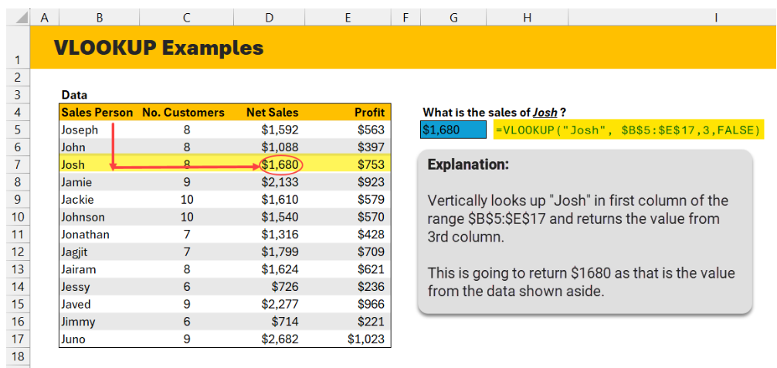
Excel Formulas for Data Analytics
Lookup and Reference Functions (VLOOKUP and HLOOKUP)

Slide 11
Excel Formulas for Data Analytics
Lookup and Reference Functions (XLOOKUP)
It helps you find values within a range and return corresponding values from another range.
It is more powerful and flexible than VLOOKUP and HLOOKUP
It is supporting searches both vertically and horizontally, as well as exact and approximate matches.
Syntax:
XLOOKUP(lookup_value, lookup_array, return_array, [if_not_found], [match_mode], [search_mode])
lookup_value
This is the first parameter, where you specify the lookup value.
It can be a manually entered value or a reference to a cell.
lookup_array
This is where your lookup data is. (It can be a range of values)
It can be on the same tab or in another tab.
It is single column or row.
It try to find the lookup_value in this column / row.

Slide 12
Excel Formulas for Data Analytics
Lookup and Reference Functions (XLOOKUP)
Syntax:
XLOOKUP(lookup_value, lookup_array, return_array, [if_not_found], [match_mode], [search_mode])
return_array
This is where your retun data is. (It can be a range of values)
It is single column or row.
[if_not_found]: It is an optional.
Specifies what to return if no match is found.
[match_mode]: It is an optional.
If match is 0 (default) then Exact match
If match is -1 then Exact match or the next smaller item.
If match is 1 then Exact match or the next larger item
If match is.2 then Wildcard match

Slide 13
Excel Formulas for Data Analytics
Lookup and Reference Functions (XLOOKUP)
Syntax:
XLOOKUP(lookup_value, lookup_array, return_array, [if_not_found], [match_mode], [search_mode])
[search_mode]: It is an optional.
If match is 1 (default) then Search from the first to last.
If match is -1 then Search from the last to first.
If match is 2 then Binary search (sorted ascending).
If match is.-2 then Binary search (sorted descending).

Slide 14
Excel Formulas for Data Analytics
Lookup and Reference Functions (Match)
Used to get the position of a specific item from a range of cells.
Position means the position of the element in the row or column where the MATCH() function is searching for the element.
Syntax
MATCH(lookup_value, lookup_array, [match_type])
lookup_value:
The value you want to find.
lookup_array:
The range of cells to search.
match_type: Optional argument:
1 (default): Finds the largest value less than or equal to lookup_value (requires data sorted in ascending order).
0: Finds the exact match.
-1: Finds the smallest value greater than or equal to lookup_value (requires data sorted in descending order)

Slide 15
Excel Formulas for Data Analytics
Lookup and Reference Functions (Index)
Uses to retrieve the value of a cell within a specified range, based on its row and column numbers.
Syntax
INDEX(array, row_num, [column_num])
array:
The range of cells or array from which you want to retrieve data.
row_num:
The row number in the array.
column_num (optional):
The column number in the array. If omitted, the function defaults to the first column.

Slide 16
Excel Formulas for Data Analytics
Note
All sessions are conducted through hands-on practice only.
Session focus on section 6 onwards.

